Slide 1

Use case: INTRO Video

Slide 2
Decrypting Victim’s SSL traffic
Decrypting SSL traffic using malicious smart phones and USB sticks
Boumediene KADDOUR – OSCP, OSWP
Cyber Security Researcher
E-mail: snboumediene@gmail.com
Mobile:+213 (0) 661 698 720

Slide 3



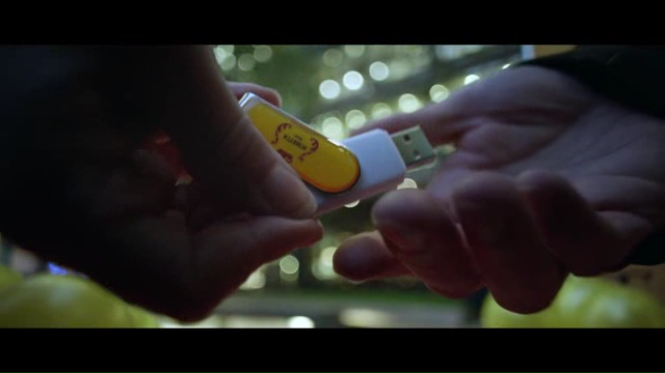

Do you think it’s real?

Slide 4

#1 - Problematic: Accept the risk

Slide 5
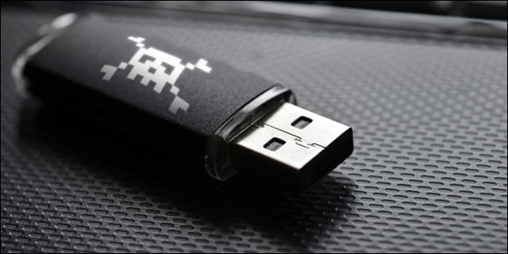
Live Demo: Bad USB

Slide 6
Proof of Concept: History
Official POC link https://srlabs.de/badusb
Presented in blackhat 2014

Slide 7
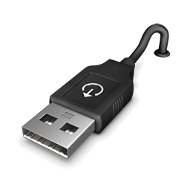

Proof of Concept: History
USB Plug and Play
Register
Set Address
Device Descriptor: Used by the device to indicate its capabilities
A device can send multiple descriptors if it supports multiple device classes like webcam+mircophone
Send descriptor
Load Driver
Set Configuration
Normal Operation
Operation Deregister
Register Again…

Slide 8



Proof of Concept
AV
Boot Loader
Controller Firmware
MASS Storage
CPU
USB Stick

Slide 9




Proof of Concept
Boot Loader
Controller Firmware
MASS Storage
CPU
USB Stick
USB Stick + Keyboard

Slide 10

#2 - Problematic: Trust Technology

Slide 11
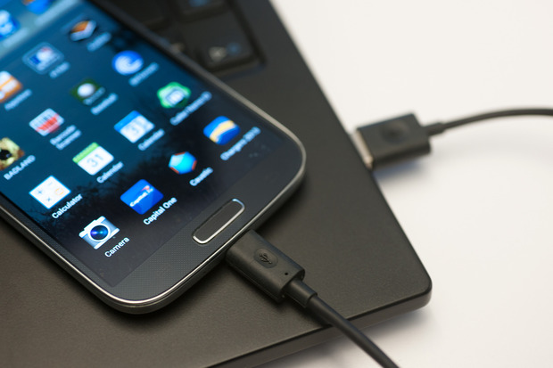
Do you trust Smart Phones ?

Slide 12

Live Demo: Malicious Smart Phone

Slide 13


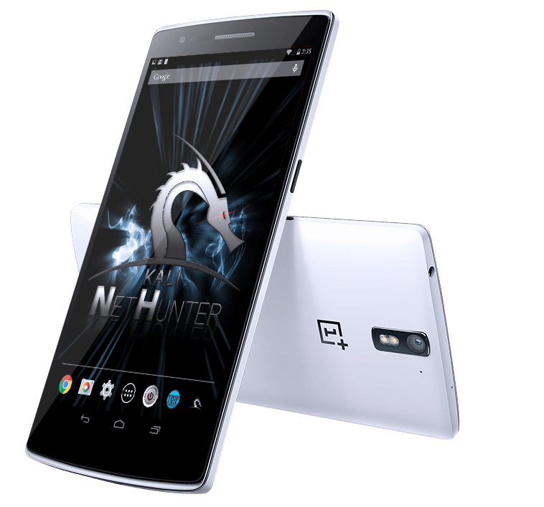


NetHunter: Android Penetration Testers Platform
Rogue Wifi Access Point
Full Kali Linux Functionalities
Bad USB Attack

Slide 14
NetHunter: Scenario 1
Information gathering to gmail

Slide 15
NetHunter: Scenario 2
Download and execute malware

Slide 16
NetHunter: Scenario 3
WIFI passwords to gmail

Slide 17
SSL Decryption
Netripper
SSLKEYLOG

Slide 18
NETRIPPER
NetRipper is a post exploitation tool targeting Windows systems which uses API hooking in order to intercept network traffic and encryption related functions from a low privileged user, being able to capture both plain-text traffic and encrypted traffic before encryption/after decryption.
https://github.com/NytroRST/NetRipper

Slide 19
NETRIPPER
Inject DLL into web browser
Ability to capture credentials before they are passed to NSS module for encryption (firefox use case)

Slide 20
NETRIPPER in components
NetRipper.exe - Configures and inject the DLL
DLL.dll - Injected DLL, hook APIs and save data to files
netripper.rb - Metasploit post-exploitation module

Slide 21
NETRIPPER in action
Requirements
Meterpreter session
Limited or elevated shell

Slide 22
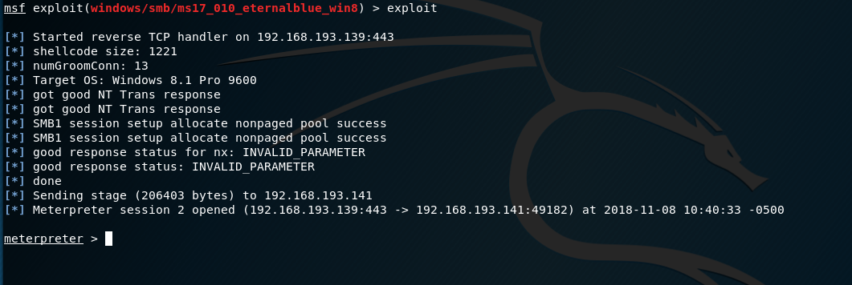
NETRIPPER in action

Slide 23
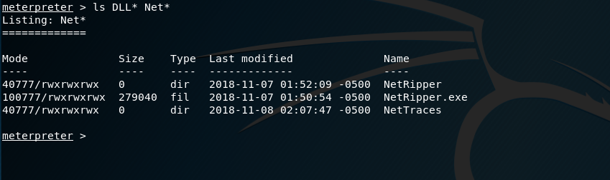
NETRIPPER in action

Slide 24
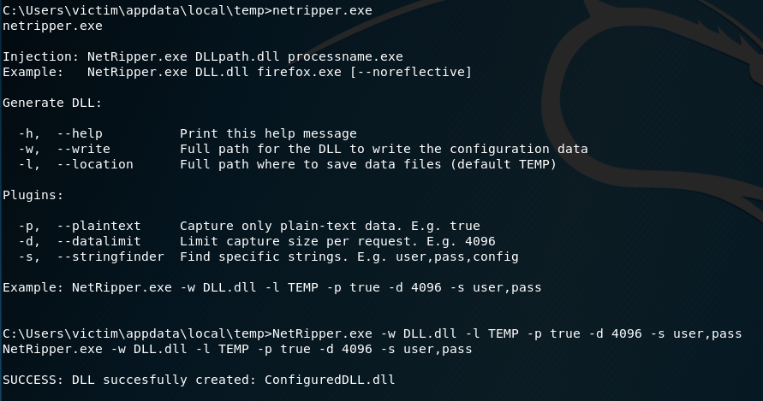
NETRIPPER in action

Slide 25
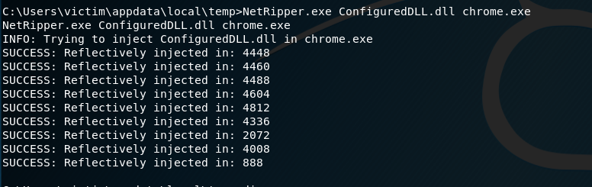
NETRIPPER in action

Slide 26
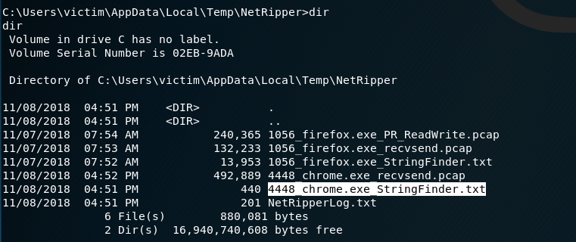
NETRIPPER in action

Slide 27

Demo time

Slide 28


Use case: Traffic Eavesdropping
11/8/2018

Slide 29
Eavesdropping: What do we need?
FTP Server
Network Sniffer
BadUSB
Automation
11/8/2018

Slide 30
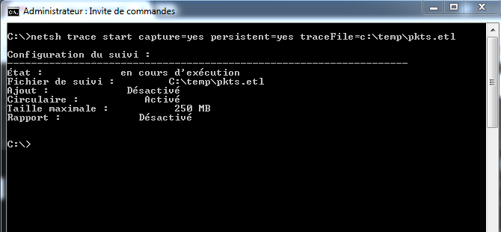
Sniffer : No Third-Party Analysis Tools
11/8/2018

Slide 31
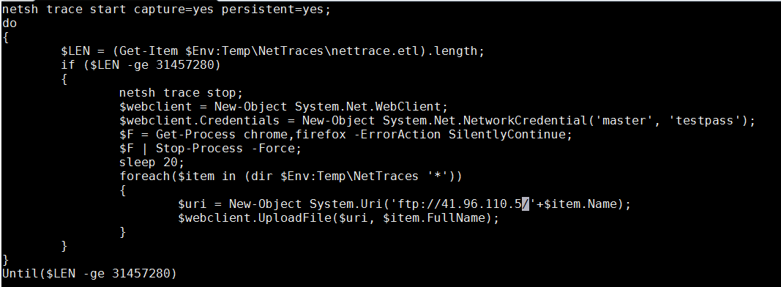
Automation : powershell
11/8/2018

Slide 32
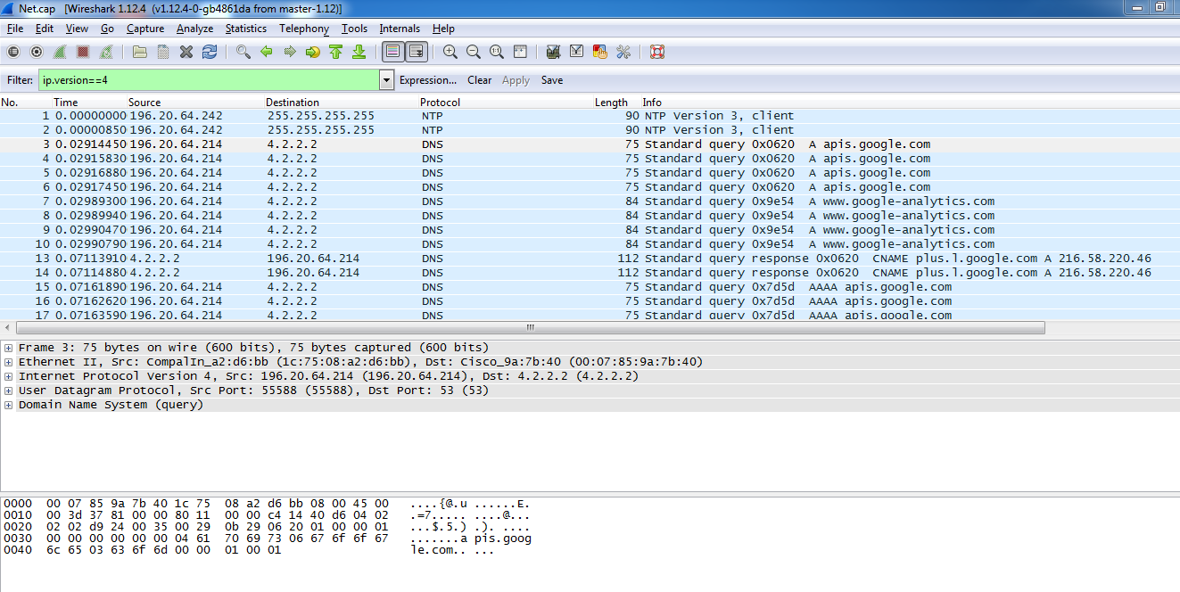
Eavesdropping: Result
11/8/2018

Slide 33

Eavesdropping: Encrypted Traffic SSL/TLS
what about Encrypted Traffic?
But wait!
11/8/2018

Slide 34
Eavesdropping: SSL RECALL
Client
Server
1
2
3
4
Client generates pre-master secret
Asymmetric encryption using public key
Send encrypted pre-master secret to server
Server decrypts with server private key
Asymmetric
Client generates master secret from pre-master secret
5
5
Server generates master secret from pre-master secret
6
Secure data exchanged using symmetric encryption and session keys
6
Client generates session keys from master secret
Server generates session keys from master secret
Symmetric

Slide 35


Eavesdropping: How To Capture Pre-Master/master Secrets?
Simply ask your browser
11/8/2018

Slide 36

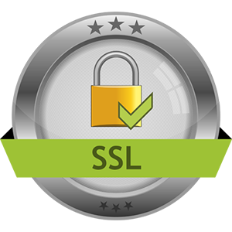

Eavesdropping: ask your browser
CLIENT_RANDOM 64 bytes
Master Secret 96 bytes
RSA 16 bytes
Pre-Master Secret 96 bytes

Slide 37

Eavesdropping: ask your browser
Logging TLS session Components
User environement variable SSLKEYLOGFILE
Browser that supports NSS module.
NSS is a set of C libraries maintained by firefox
11/8/2018

Slide 38
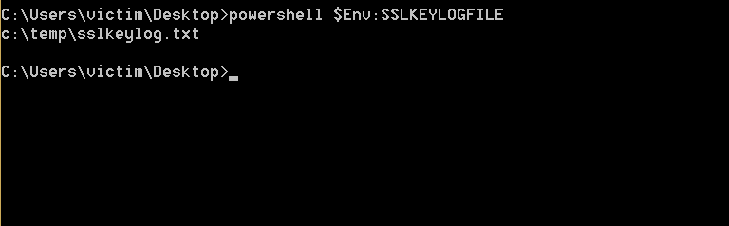
SSLKEYLOGFILE Env Variable

Slide 39
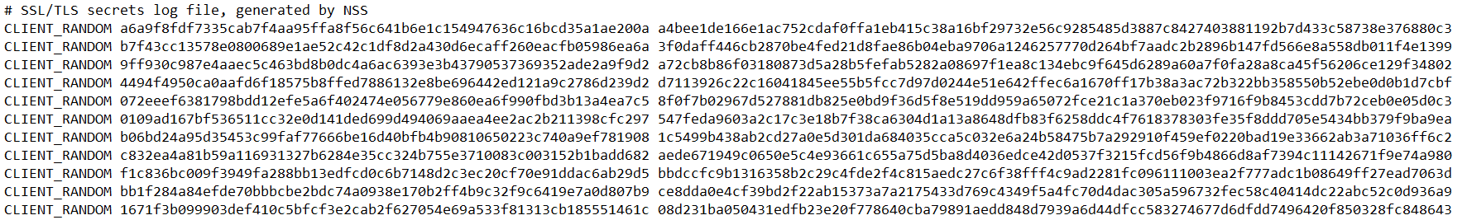
SSLKEYLOGFILE file

Slide 40
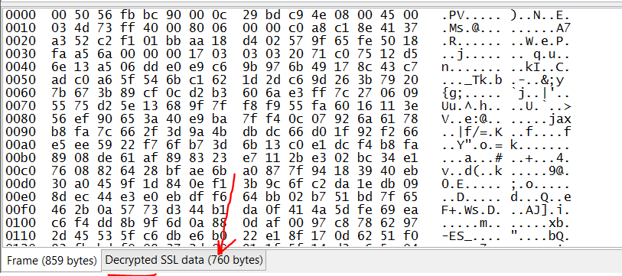
Wireshark Decrypted data section

Slide 41
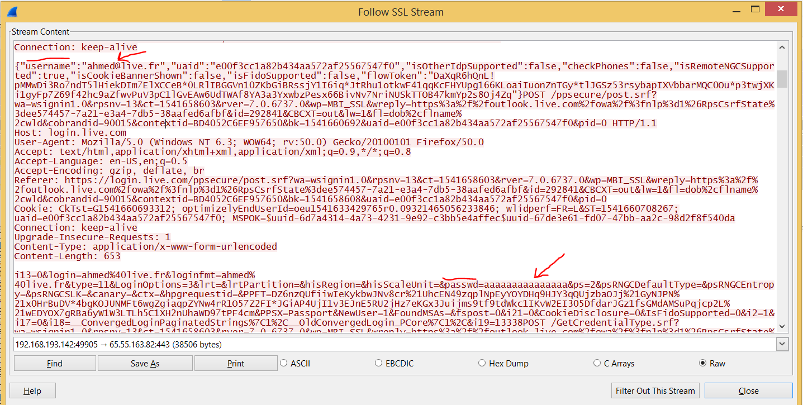
Wireshark Hotmail Creds

Slide 42
SSL Decryption: Video Demo

Slide 43

Countermeasures

Slide 44

EoF
Thank you
11/8/2018

